Slide 1
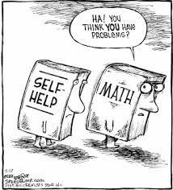
Factoring Expressions

Slide 2
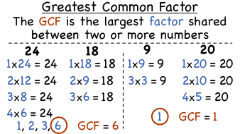
Greatest Common Factor (GCF)
The first thing you need to figure out before knowing how to factor is to be able to find the GREATEST COMMON FACTOR

Slide 3
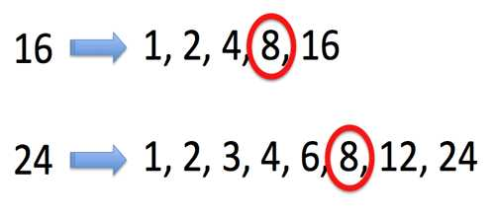
All those numbers can be multiplied by another number to get either 16 or 4.
The greatest common factor for 16 and 24 is 8 because 8 is the largest number that can be multiplied into 16 and 24.

Slide 4
There are many different ways to find the GCF
The preferred (and simplest way) is to list out the factors
Example:
15: 1, 3, 5, 15
But if you use a different way AND IT WORKS then by all means use that method.

Slide 5
GCF Practice
Find the greatest common factor for the following
6 and 15
The answer and explanation are on the next slide

Slide 6
6: 1, 2, 3, 6
15: 1, 3, 5, 15
The GCF is 3
A way to check your work is to multiply the first number by the last then the second number by the second to last and so on. When multiplied they should equal the number you are finding the factors for.
(1 x 6) (2 x 3) both equal 6

Slide 7
GCF Life Hacks
The next few slides are going to show you some “quality of life” perks, shortcuts, or more efficient ways to find the GCF.

Slide 8
Sandwich Method
I’m sure there’s a better name for this but I like the “sandwich method.”
This is where you start with 1 and write down what it can be multiplied by at the end of the list.
For an example, we’ll find the factors for 20
20: 1, 20
So I started with 1 and made a decent sized space and put down 20. Now I know all the other factors will be between them.

Slide 9
Sandwich Method
20: 1, 20
Since 20 is an EVEN NUMBER I know 2 can go into it. So I place a 2 in as well as how many times 2 goes into 20 (spoiler: it’s ten times).
20: 1, 2, 10, 20
The process continues until your lower and upper numbers meet. 3 doesn’t go into 20 (15-18-21-24) but 4 does when multiplied by 5.
20: 1, 2, 4, 5, 10, 20
With no numbers left between 4 and 5 I know I’m done.

Slide 10
Take out the Little One first
If I had to find the GCF between 12 and 30 I would first list out the factors
A shortcut would be to go for the smaller number first. So let’s find the factors for 12
12: 1, 2, 3, 4, 6, 12
With the factors written for 12 we can see if any of those numbers go into 30. This way we avoid spending time finding higher number factors for 30 which won’t go into 12.

Slide 11
Take out the Little One first
12: 1, 2, 3, 4, 6, 12
We start with 12 because it’s the largest number. Does 12 go evenly into 30?
12 – 24 – 36 NOPE
What about 6, the second largest number? Does 6 go into 30?
6 – 12 – 18 – 24 – 30 It does!
6 is the highest number which can be evenly multiplied into 12 and 30 making it the GREATEST COMMON FACTOR

Slide 12
Practice (answers on next slide)
Find the GCF for the following pairs
8 and 20
9 and 15
52 and 13
48 and 66

Slide 13
Practice Answers
Find the GCF for the following pairs
8 and 20 GCF = 4
9 and 15 GCF = 3
52 and 13 GCF = 13
48 and 66 GCF = 6

Slide 14
Factoring
Once you feel confident in finding the greatest common factor then factoring will be very simple and (honestly) kinda fun.
Factoring is “splitting” an expression into a multiplication of smaller expressions.
It’s always, in many ways, the exact opposite of distributing.
Let’s see how all that makes sense.

Slide 15
How Factoring Works
Let’s see you have the expression (6x + 24) and you need a smaller coefficient for your variable. 6 is too much for me right now – I need something smaller.
To have a smaller coefficient we must find the GCF for all the terms inside the parenthesis and “pull it out”
The next slide will start this process

Slide 16
Factoring 6x + 24
6: 1, 2, 3, 6
24: 1, 2, 3, 4, 6, 8, 12, 24
GCF = 6
Since the GCF is 6 we take it out. 6( ? + ? )
Now we need to fill in the parenthesis so how many times does 6 go into 6x? To figure this out we divide 6 by 6 and get 1.
So our updated expression should look like:
6(1x + ? ) OR 6(x + ?)
REMEMBER
You can multiply variables by constants because multiplication is just Extreme Adding
Ex: 2f x 4 = 2f + 2f + 2f + 2f

Slide 17
Factoring 6x + 24
6(1x + ? ) OR 6(x + ?)
Next, we see how many times 6 goes into 24. 24 divided by 6 is 4. This means 4 would go inside the parenthesis.
6(x + 4)
This is the final answer if you were asked to factor
Remember: Much like simplifying fractions, when factoring you want to make it so you can’t factor anymore.
WHAT THIS MEANS: You could factor out 2 and have 2(3 + 12) but that’s not fully factored out. It would be simplifying 4/8 to 2/4 and not ½. Find the smallest/simplest form (through GCF)

Slide 18
Factoring 6x + 24
Checking your work
To make sure you factored correctly you apply the distributive property to your answer and see if you come up with the original expression.
So,
6(x + 4)
(6 * x) + (6 * 4)
6x + 24
Nice….
Knowing you factored the GCF
If the GCF of the numbers in the parenthesis is 1 then you found the correct GCF to factor

Slide 19
Knowing you Factored the GCF
You may have factored an expression and believe it’s perfect. But maybe you didn’t. What’s wrong with the following factored expression:
12k + 32
We factor out 2 so it becomes 2(6k + 16)
Is 4 the GCF? No, it’s not. How can you tell without listing all the factors? It can be found in the second part of the answer
(6k + 16)
Think about what may be wrong with this before going to the next slide.

Slide 20
Knowing you Factored the GCF
(6k + 16)
You have 6 as the coefficient and 166 as the constant in the parenthesis. For fun, what’s the GCF? Correct, it’s 2. That’s not good.
If 12k + 32 was factored correctly the GCF between the numbers in the parentheses would (and should) be 1.
Let’s factor it correctly. 12k + 32 becomes 8(3k + 8)
The GCF between 3 and 8 is 1. Now it’s correct!

Slide 21
Practice (answers on next slide)
Factor the following expression
3x + 24
12x + 32
9t + 36
24c + 60

Slide 22
Practice Answers
Factor the following expression
3x + 24 3(x + 8)
12x + 32 4(3x + 8)
9t + 36 9(t + 4)
24c + 60 12(2c + 5)

Slide 23
Important things to remember and be able to do
If you’re struggling with finding factors for numbers, you need to be practicing as much as you can. My advice is do find the factors for a few numbers each night. This is a skill best learned through repetition.
You can multiply unlike terms (3 x 5g = 15g) but you CANNOT ADD like terms (3 + 5g = 3 + 5g)
You can check your factoring answers by applying the distributive property. If your answer after distributing is the original problem, then you did it right.
When factoring make sure you’re using the GREATEST COMMON FACTOR. You need to be factoring out the largest number you can to have the expression in its simplest factored form.

