Slide 1
Solving and Graphing Inequalities

Slide 2
Inequalities
The way you will solve these is very similar to how you solved equations just recently.
You must isolate the variable and determine the value (ex: x = 5 or y < 4)

Slide 3
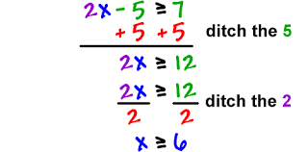
Solving Inequalities
As you look at the example below realize that x can equal an INFINITE amount of numbers as long as they are GREATER THAN OR EQUAL TO 6
Can x = 8?
Can x = 6?
Can x = 4?
Replace x with the number to find out

Slide 4
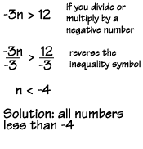
The Crazy Negative Rule

Slide 5
Look for when the inequality sign switches and WHY

Slide 6
Graphing Inequalities
The circle is CLOSED or FILLED IN if it can equal the number
The circle is OPEN or BLANK if the variable CANNOT equal the number

Slide 7
Ways to Remember Open or Closed
A ≥ has more lines than > so it will take more ink/lead. Just look a closed circle
≥ = ● > = ○
On the number line, if the variable can equal the number then it will be filled in. Open circles are blank because the number is not filled in.

Slide 8
Quick Practice (answers on next slides)
10x ≥ 20
X + 6 < 8
-3x > 3

Slide 9
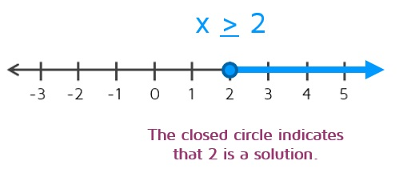
Answer for #1

Slide 10
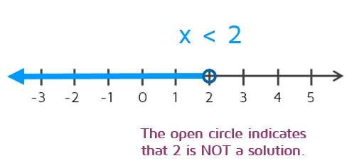
Answer for #2

Slide 11
Answer for #3
X < -1
Remember: The inequality sign changes when you either DIVIDE OR MULTIPLY by a negative. X went from being greater than (>) to less than (<).

