Slide 1
Reflecting on Coordinate Planes

Slide 2
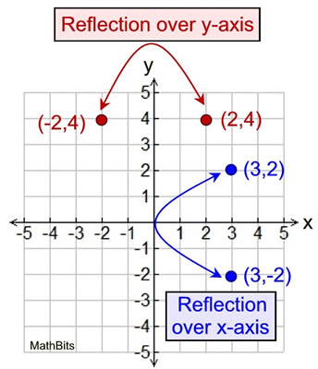
“Reflecting”
When your plot jumps over to the other side of an axis it “reflects”
When you reflect a number it either goes from positive to negative or negative to positive
You just sign the sign of the number opposite of the axis you just jumped.
Example to the right (the red one):
When you reflect over the y-axis you’re still ON the SAME PART of the y-axis so the value doesn’t change.
X does change from -2 to 2.

Slide 3
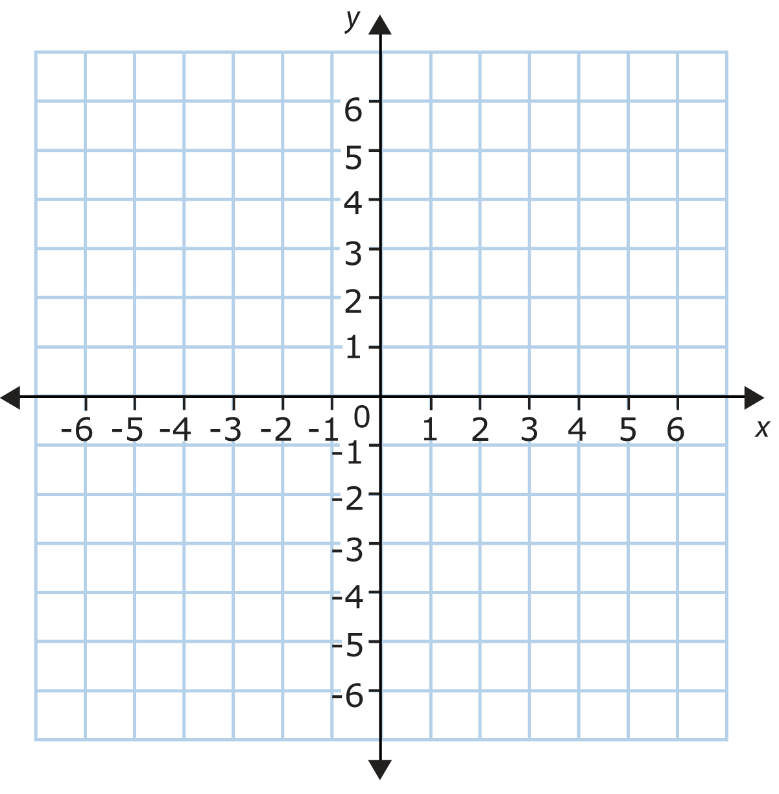
Example 1:
If (-4,-1) is reflected over the x-axis, what would be its new coordinates?

Slide 4
Example 2:
If (3,-2) is reflected over the y-axis, what would be its new coordinates?

Slide 5
Henry plotted point X at (-3, 6). He then reflected this point over the x-axis and labeled this point Y. Then he reflected Point Y over the y-axis to get point Z.
What is the ordered pair for point Z?
Point Y: ______Point Z: ______

Slide 6
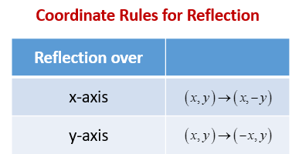
Review
How are the coordinates of a point affected by a reflection of the point over the x-axis?
The y-coordinate changes to its opposite.
How are the coordinates of a point affected by a reflection of the point over the y-axis?
The x-coordinate changes to its opposite.

