Slide 1
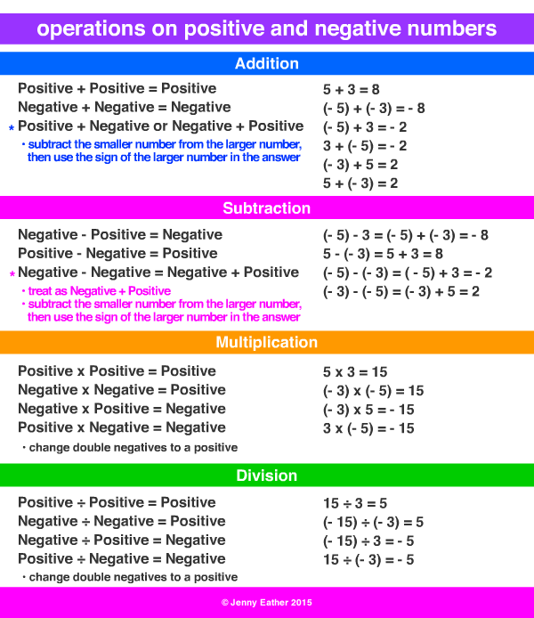
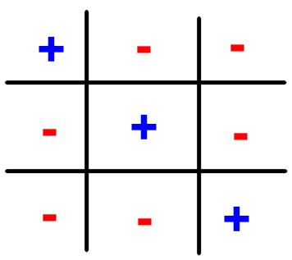
Signs Review
Integer rules from the start of the year apply to rational numbers.

Slide 2
Practice
Only answer whether the answer is POSITIVE or NEGATIVE
4 + 4

Slide 3
Practice
Only answer whether the answer is POSITIVE or NEGATIVE
4 + 4
The answer is positive because both numbers are positive

Slide 4
Practice
Only answer whether the answer is POSITIVE or NEGATIVE
4 – 5

Slide 5
Practice
Only answer whether the answer is POSITIVE or NEGATIVE
4 – 5
The answer is negative because after Keep Change Change 5 becomes negative. Negative 5 has a greater absolute value than positive 4

Slide 6
Practice
Only answer whether the answer is POSITIVE or NEGATIVE
5 – 4

Slide 7
Practice
Only answer whether the answer is POSITIVE or NEGATIVE
5 – 4
The answer is positive because 5 has a greater absolute value than negative 4

Slide 8
Practice
Only answer whether the answer is POSITIVE or NEGATIVE
-4 + -3

Slide 9
Practice
Only answer whether the answer is POSITIVE or NEGATIVE
-4 + -3
The answer is negative because a negative plus a negative is a larger negative

Slide 10
Practice
Only answer whether the answer is POSITIVE or NEGATIVE
-4 – 3

Slide 11
Practice
Only answer whether the answer is POSITIVE or NEGATIVE
-4 – 3
The answer is negative because after keep change change 3 becomes negative and a negative plus a negative becomes a larger negative

Slide 12
Practice
Only answer whether the answer is POSITIVE or NEGATIVE
3 – (-4)

Slide 13
Practice
Only answer whether the answer is POSITIVE or NEGATIVE
3 – (-4)
The answer is positive because after Keep Change Change, the sentence reads 3 + 4 and a positive plus a positive is a larger positive.

Slide 14
Practice
Only answer whether the answer is POSITIVE or NEGATIVE
4 x 4

Slide 15
Practice
Only answer whether the answer is POSITIVE or NEGATIVE
4 x 4
The answer is positive when both signs are the same. They could be both positive or both negative.

Slide 16
Practice
Only answer whether the answer is POSITIVE or NEGATIVE
4 x -4

Slide 17
Practice
Only answer whether the answer is POSITIVE or NEGATIVE
4 x -4
The answer is negative because the signs are different (one negative and one positive)

Slide 18
Practice
Only answer whether the answer is POSITIVE or NEGATIVE
-4 x -4

Slide 19
Practice
Only answer whether the answer is POSITIVE or NEGATIVE
-4 x -4
The answer is positive when both signs are the same. They could be both positive or both negative.

Slide 20
Practice
Only answer whether the answer is POSITIVE or NEGATIVE
4 ÷ -4

Slide 21
Practice
Only answer whether the answer is POSITIVE or NEGATIVE
4 ÷ -4
The answer is negative because the signs are different (one negative and one positive)

Slide 22
Practice
Only answer whether the answer is POSITIVE or NEGATIVE
-4 ÷ -4

Slide 23
Practice
Only answer whether the answer is POSITIVE or NEGATIVE
-4 ÷ -4
The answer is positive when both signs are the same. They could be both positive or both negative.

Slide 24
Practice
Only answer whether the answer is POSITIVE or NEGATIVE
4 x -4 x -4

Slide 25
Practice
Only answer whether the answer is POSITIVE or NEGATIVE
4 x -4 x -4
The answer is positive after you perform both operations. 4 x -4 = -16. -16 x -4 = 64.

